Slide 1
Wide-area TLO to solve
customer issues through
open innovation
Campus Create Corporation

Slide 2
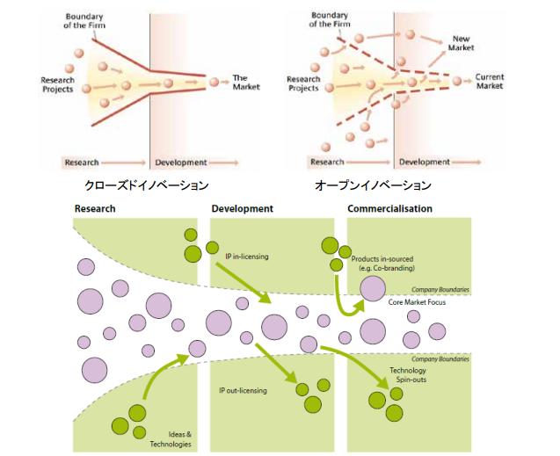
Open-Innovation（１）
Closed-Innovation
Open-Innovation
Exhibit：
MIT Sloan Management Review, “Top 10 Lessons on the New Business of Innovation”, 2011 http://sloanreview.mit.edu/files/2011/06/INS0111-Top-Ten-Innovation.pdfUniversity of Cambridge, “How to Implement Open Innovation –Lessons from studying large multinational companies” http://www.ifm.eng.cam.ac.uk/uploads/Resources/Reports/OI_Report.pdf

Slide 3
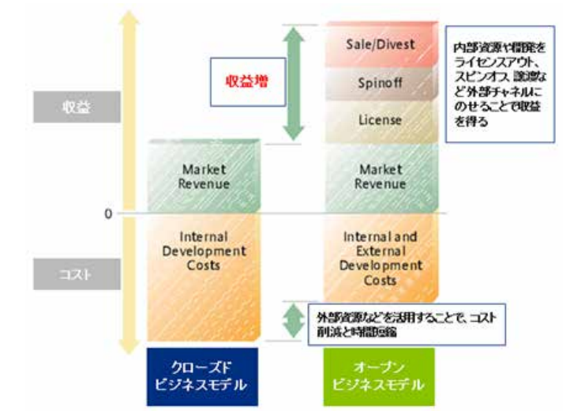
Open-Innovation（２）
Earn money by placing
internal resources and
development
on external channels,
such as licensing out,
spin-offs, and transfers
Sale/Devest
Revenue
increase
Spinoff
Revenue
License
Market
Revenue
Market
Revenue
Internal
Development
Costs
Internal and
External
Development
Costs
cost
Cost reduction and time reduction by utilizing
external resources
Closed business
model
Open business
model
Exhibit：
Henry Chesbrough, “Why Companies Should Have Open Business Models”, MIT Sloan Management Review, 2007 http://sloanreview.mit.edu/article/why-companies-should-have-open-business-models/

Slide 4
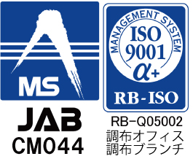
Corporate Profile
Company: Campuscreate Corporation
Capital: ¥81.6 million (Capital increase in October 2007)
Tsuketate: September 1, 1999
Acceptance: Approved TLO (Ministry of Economy, Trade and Industry and Ministry of Education, Culture, Sports, Science and Technology)
Principal stocks: 136 persons, including faculty and staff of the University of Electro-Communications and graduates
Number of Employees: 17
*Acquisition of ISO 9001 certification
[quality goal]
TLO(Technology Licensing Organization) which provides businesses and
services that earn customer trust and satisfaction
*trademark acquisition
"Data-Driven Industry-Academia-Government Collaboration"
Registration number: No. 6135646 Application date: May 28, 2018 Registration Date: April 5, 2019

Slide 5
Features and Advantages
Company organization
University of Tokyo | Hiroshima Institute of Technology | Yamaguchi University
Keio University | Rissho University | Kagawa University
Kwansei Gakuin University | Ritsumeikan University | Iwate University
Kumamoto University | Waseda University | Gunma University
Osaka Prefectural University | Sophia University | Saitama University
Kobe University | Aoyama Gakuin University | Tokyo Metropolitan University Tokyo
Tokai University | Chuo University | Japan Veterinary and Life Sciences University
Shizuoka University | Kagoshima University | Tokyo University of Agriculture
Shibaura Institute of Technology | Tokyo Institute of Technology | Kindai University
Shinshu University | University of Tsukuba | Chubu University
Chiba Institute of Technology | Toyohashi University of Technology | Nagoya City University
Utsunomiya University | Hyogo Prefectural University | Kochi University
Yamanashi University | Chiba University | Kochi College of Technology
Hokkaido University | St. Luke's International University | Chiba University
Tokyo Metropolitan University | Kyoto Institute of Technology | Ochanomizu University
Toyama Prefectural University | Osaka City University | Showa Women's University
Nippon Medical School | Hakodate Mirai University | Gifu University
Hiroshima University | Nagasaki University | Aichi Institute of Technology
Although Campus Create is a TLO of
the University of Electro-Communications,
we can develop our own service menu
as needed to meet the needs of customer
companies since it is operated as a stock company
and does not include the capital of the university.
Wide area TLO
We can research seeds and provide collaborative supports throughout Japan.
Needs first
Rather than with research seeds, we can ask for the needs of client companies and conduct research on a wide range of research seeds
that can solve the client needs.
[Past examples of cooperation and support]

Slide 6
Campus Create 20th term sales
Period: August 1, 2018 to July 31, 2019
Estimated sales: nearly 300 million yen (10 ~ 15% increase from the previous year)
- Orders received from universities: approx. 4%
*Event planning and management, course planning and management, etc.
(In principle, universities are not required to pay for basic matching activities among industry, academia and
government.)
- License revenue: approx. 2%
*1) The amount of licenses for patents held by universities
(When our company transfers technology, companies pay to partner universities.
The university pays a portion of the license revenue to our company.)
*2) Licenses for patents held by our company (Pre-incorporation patents, etc.)
- Subsidies received (non-operating income): approx. 1%
*For three managed companies in strategic core technology enhancement support business
Labor and overhead costs (Ended at the end of March 2019)
Sales of 90% or more excluding the above are consulting and outsourcing expenses from
companies and local governments.
Estimated ordinary income: approx. 10 million yen to 15 million yen * Target: 30 million yen in 2 years

Slide 7
Service Menu
1. Comprehensive consulting
2. Industry-Academia-Government Collaboration
3. International collaboration

Slide 8
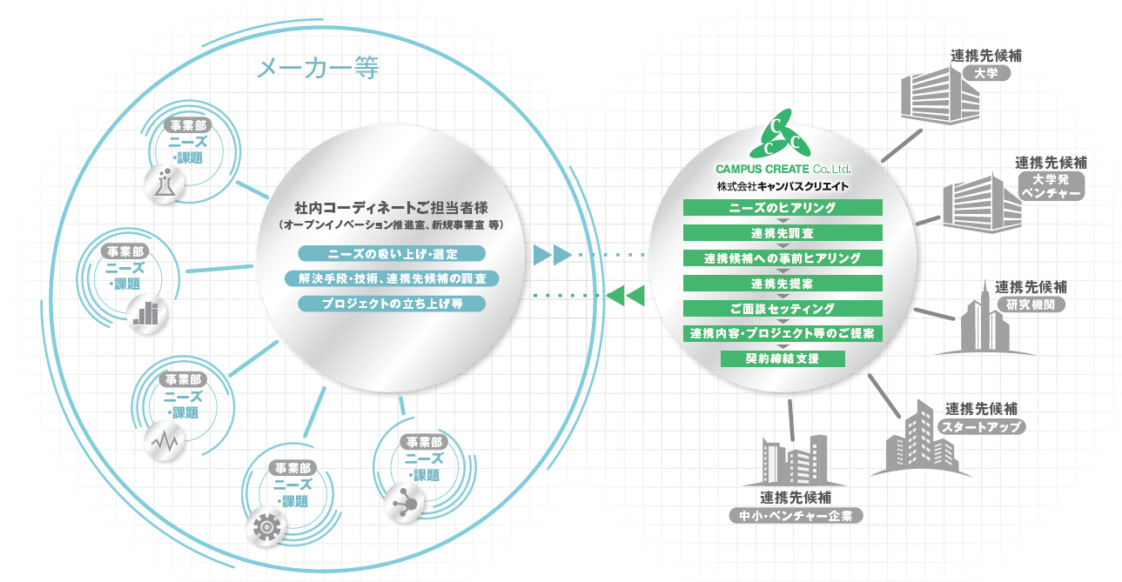
1. Comprehensive consulting
The use of external organizations for new business development and important issues is increasing. We provide comprehensive consulting in a variety forms, such as
research activities, events, and seminar planning to meet the needs of customer companies.
CAMPUS CREATE Co.,Ltd.
Contact candidates
Manufactures, etc.
University
Department A
1.Needs hearing
Needs/Tasks
2.Partner survey
Contact candidates
A person in charge
(Open-innovation Division,
New Business Development Division etc.)
3.Pre-hearing to partner candidates
University venture company
4.Partner proposal
Department B
Finding and selecting seeds
5.Interview setting
Needs/Tasks
Investigation of solutions / technologies and contact candidates
6.Proposal of cooperation contents, projects, etc.
Contact candidates
Research Institution
Launching projects etc.
7.Interview setting
8.Contract conclusion support
Department C
Needs/Tasks
Contact candidates
Department E
Startup
Department D
Needs/Tasks
Needs/Tasks
Contact candidates
Small and medium-sized enterprises
Venture company

Slide 9
1. Characteristics of the search for seeds
In the search for researchers, we will conduct research to look for seeds on the following areas that are difficult for companies to conduct on their own.
Utilizing collaborations among coordinators
Proposals utilizing different fields
Based on the results of many wide-area collaborations, we have a lot of connections with university coordinators, and we can look for researchers while getting objective information from them.
By utilizing our company's existing networks and other resources, we search for seeds that cam be different from companies' specialized fields, then propose effective solutions to problems.
In-depth hearing
We ask companies about things that are difficult to say to researchers (real prospects in research, organization of laboratories, possibility of collaboration, factors of anxiety, etc.), then we have a deep hearing with researchers by getting them to trust without disclosing the company name.
Proposals through cooperation with multiple seeds
Even if a company's problem cannot be solved by a single seed, we propose another solutions by cooperating with multiple seeds.
Research using an artificial intelligence knowledge system
By building unique datasets suitable for industry-academia collaboration that target web pages (Collection of seeds from universities, R & D subsidy reports from public institutions, press releases, etc.) that are difficult to find through regular search, you can search across the content of files while constantly crawling the latest information.

Slide 10
1. Support for improvement of matching accuracy
The following measures will be implemented to improve the accuracy of cooperation to meet the needs of companies.
Making collaboration proposal
After the preliminary verification, we will discuss with researchers and make a proposal. The research proposal specifies the research content, schedule, and deliverables. By working with researchers, we will enhance their understanding and awareness of the contents of joint research. We will also provide you an estimate of the necessary research expenses together with the proposal.
Conductuing pre-validation prior to collaboration
Prior to the actual implementation of collaboration, preliminary studies are conducted using existing data and sample products, and the possibility of collaboration and assignment are examined. By conducting preliminary verification, the output of researchers can also be checked, making it easier to establish a cooperative image.
The preliminary examination might be conducted free of charge, if not, we will negotiate to conduct it at the lowest possible cost.

Slide 11
1. Example
Type of industry | Comprehensive content | Cost/Duration
Manufacturing and sales companies of resins | ・Survey of researchers who can solve difficult problems that could not be solved internally ・Comprehensive research into new businesses ・Search for a technical advisor = > The above search, hearing, interview coordination, and contract support are conducted. | 5 million yen/year (About 6 cases)
Planning and sales companies for beauty and health products | ・Survey of seeds that could be used for selling beauty and health products (monthly report) = > The above search, hearing, and interview coordination are conducted. | 4 million yen/year
Mobile handset companies | ・Collection of information on related technologies at JST, NEDO, etc. ・Support for holding workshops at universities ・Support for holding seminars and symposiums ・Making a research seeds map | ¥8 million/year
Processed food company | ・Comprehensive research into new businesses = > The above search, hearing, interview coordination, and contract support are conducted. ・Disclosing needs ・Conducting partner recruitment event | 1.5 million yen/4 months Held at 5 million/2 sites

Slide 12
1. Example
firm type | comprehensive content | Cost/Duration
Manufacturing and sales company for chemical products | ・Research seeds search, interviews with researchers, interview coordination, (pre-validation), preparation of joint research proposals, and contract support are conducted. | 1.5 million yen/10 months In addition to the above, 150,000 yen per 1 pre-inspection (It may be paid to researchers separately)
Gaming company | ・Comprehensive search of AI research seeds, interviews with researchers, interview coordination, (pre-validation), preparation of joint research proposals, and contract support are conducted. | 1.5 million yen/10 months In addition to the above, 150,000 yen per 1 pre-inspection (It may be paid to researchers separately)
Automotive parts companies | ・Comprehensive search for sterilization and deodorization ・Search for research seeds about issues that cannot be solved by the company, including interviews with researchers | 600,000 yen/1 month 600,000 yen/2 months
Venture company | ・Searching and interviewing researchers who utilize LiDER to making use of it for in-house issues (About 30 research seeds) | 500,000 yen/2 months
Measurement equipment sales companies | ・Comprehensive research into new businesses | 500,000 yen/1 month

Slide 13
1. Approximate cost
This is a basic service charge. (We will make estimates based on the difficulty of your needs and your requests.)
1
Comprehensive survey of 600,000 yen
Research on issues that are difficult to solve internally
(including interviews with researchers)
600,000 yen
Comprehensive survey
Interviews with researchers
Interview ~
contract negotiation
1.5 million yen
Researcher search
After exhaustive research
Interview with researchers ~ Interview ~
Contract negotiation
1 million yen
2
Interview
3
Implementation of
pre-verification
¥150,000/month/subject
*There are cases where there is a reward for researchers other than the above.
(Pre-validation)
4
Proposal Development
5
Contract negotiation
6
Post-Launch Support
Joint Research Agreement
1.5 million yen/year for annual continuation: 1.2 million yen/year
*In addition to the above, we will receive expenses for joint research and technical guidance for researchers.
*If there are a lot of activities in our company, (Conducting human subject experiments, fusing multiple seeds, etc.) iit will be discussed separately.
*Travel expenses will be charged separately.

Slide 14
2. Industry-Academia-Government Collaboration
We will support the smooth implementation of industry-academia-government collaboration.
1
2
3
Researcher search
Interview
(Pre-validation)
・Needs hearing
・Search
・Hearing with researchers
・Follow-up to those who declined
・NDA contract adjustment
・Meeting coordination and meeting attendance
・Proposals for future development
・Follow-up after the interview
・Prior verification content review support
・Negotiation with researchers on the details of implementation
・Contract procedure
・Researchers follow-up
4
Proposal
Development
5
6
Contract negotiation
Post-Launch Support
・Develop joint research proposals with researchers
・Research content/division of roles
・Deliverables
・Schedule
・Expenses, etc.
・Joint research contract negotiations
・Patent related
・Handling Deliverables
・Presentation at academic conferences
・Participation in the progress meeting
・Schedule management
・Response to complaints from both parties
・Support for intellectual property negotiations
・Support for search of subcontractors and sales channels
・Support for obtaining external funds

Slide 15
2-1. Contract negotiation and procedure support
2. Roles of our company before and after
the conclusion
There are a lot of unusual things in the process of making a contract with a university, etc., and it takes time. However, since our company is TLO and also a company, and has a track record of collaborating with many universities, etc., we can understand the positions of both companies and universities, so that we can proceed contract negotiations and procedures smoothly.
In addition, considering requests of companies and the background of the cooperation, we proceed the negotiation by explaining well to the person in charge of the contract.
Collaborative research
contract
Consulting
contract
Collaborative research
application form
Software
Licensing
contract

Slide 16
2-2. Progress management and response to complaints
2. Roles of our company before and after the conclusion
We conduct coordinating the holding of regular progress meetings, participating in meetings, and preparing the minutes of meetings, and support for the smooth progress of cooperation even after it has started.
We will manage the progress based on the schedule of the proposal,
and we can mediate between customer companies and researchers. We tell the other party about the complaints, requests, and consultations that are difficult for them to tell the other party directly, without damaging the relationship of the cooperation itself.
Company
CAMPUS CREATE
Researcher

Slide 17
2-3. Support for intellectual property negotiations
2. Roles of our company before and after
the conclusion
Our company does not claim any intellectual property that may arise during the collaboration. For this reason, we will provide support for smooth negotiations on intellectual property that occur during the collaboration from a neutral standpoint.
By participating in the progress meeting and understanding the content of daily cooperation, we will objectively inform the person in charge of the IP of the other party about the background of the generated IP and the requests and opinions of both parties.
In addition, the relationship between the two countries may deteriorate as intellectual property negotiations proceed. However, it is possible for us to proceed with negotiations without any change.
・Assistance in consultation of application conditions
・Objective explanation of application background
・Support for coordination of application contents
・Schedule management until application
・Support for consultations on licensing conditions, etc.

Slide 18
2-4.Supporting development after collaboration
2. Roles of our company before and after
the conclusion
As joint research progresses, there may be talk of increasing the scale of research and producing prototypes. In doing so, we will assist you in finding more partners and obtaining external funds.
Company
CAMPUS
CREATE
Researcher
Scale up
supporting company
collaborative research
Prototype implementer
Incubator
Support for obtaining external funds

Slide 19
2. Proposal image
Based on the preliminary verification results and discussions with your company, we will work with researchers to prepare the following proposal.
Results of prior study
Schedule
Issue A
Issue B
 | April | June | August | October | ・・・
0 | ★
1
2
3
・・・
conference | 〇 | 〇 | ◎ | ◎
Research content
[your company] 0. Materials provided
[University] 1. Experiment to Solve Problem A
[University] 2. Data Analysis and Algorithm Construction
[Both] 3. Evaluation
[University] 4. Simulation to Solve Problem B
...
Deliverables
cost
experimental data
algorithm specification
simulation result
report
consumables expenses 200,000 yen
equipment cost 800,000 yen
honorarium 100,000 yen
...

Slide 20
2. Collaboration with researchers and cost flow
■Form of contract
Your company
Researcher
Experiment and algorithm construction
Evaluation, analysis, etc.
・Provision of information
and materials
・Evaluation and analysis,
etc.
CAMPUS
CREATE
The joint research is contracted by three parties, and we will participate in the cooperation after the conclusion of the joint research contract.
・Progress management
and response to complaints
・Support for intellectual property
negotiations
■Flow of costs
Your company
Researcher
The total cost of research and our company consulting will be paid to our company and then paid to the researchers.
Consulting expense
+
Payment for researchers
・Joint research
expenses
・Cost of technical
guidance
・Investigation
expenses, etc.
CAMPUS
CREATE

Slide 21
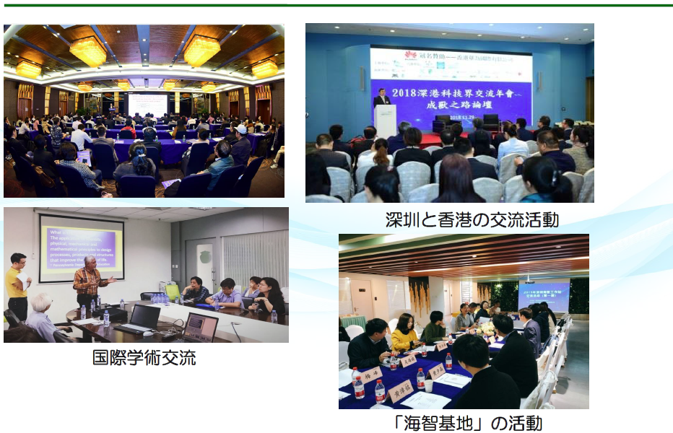
3.International collaboration

Slide 22
3.International collaboration

Slide 23
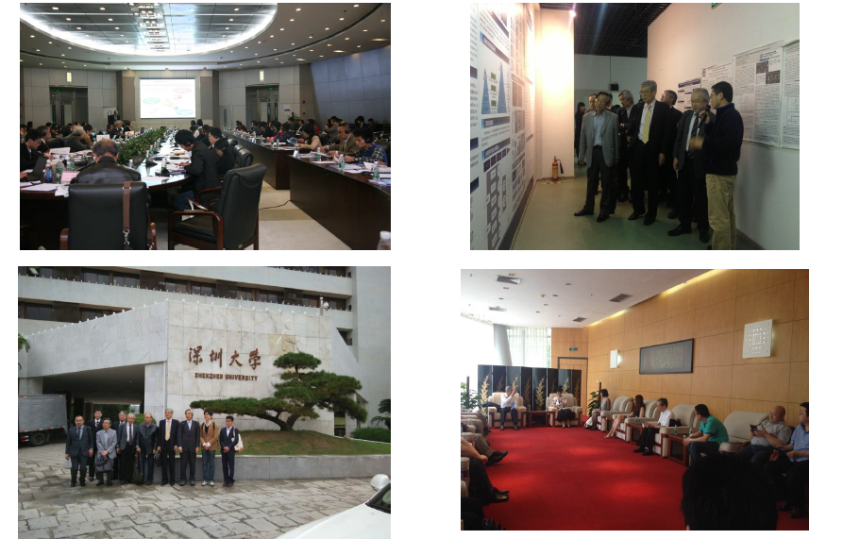
3.International collaboration
事例１：電通大学産学官連携新技術説明会＠シンセン
Case 1:The University of Electro-Communications Industry-academia-government collaboration new technology briefing @ Shenzhen

Slide 24
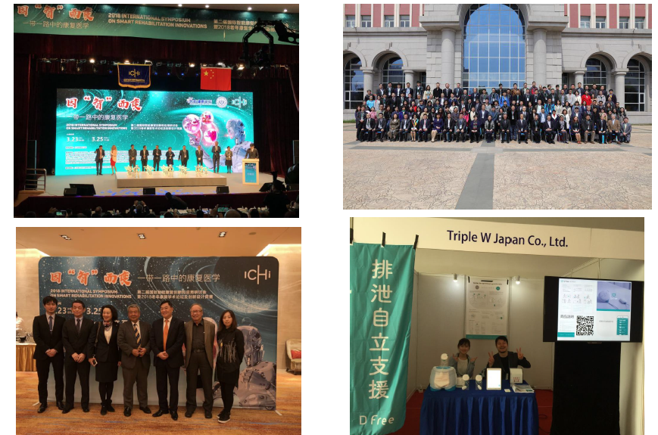
3.International collaboration
事例2：AI介護・リハビリシンポジウム＠上海
Case 2: Artificial Intelligence care and rehabilitation symposium @ Shanghai

Slide 25
3. Examples of International Operations
(For domestic companies)
Example 1. Shenzhen Study Tour (3 days and 2 nights)
Content: Planning, conducting and accompanying Shenzhen inspection tours
On-site visits (Chinese affiliated companies, university ventures, university laboratories, etc.)
Participation and tour of local exhibitions
Cost: 750,000 yen ~ (excluding tax)
*Our company companion staff: total of 2
(One person from the head office in Japan and one person from the local office in Shenzhen)
*The above travel expenses include travel expenses for our company companion staff (Japan Head
Office: 1 person) ,both overseas and local transportation.
Example 2. Support for IP overseas licensing
Content: Gathering and providing information on your company IP related companies all over China
Follow-up support services and closing of IP businesses in your company
Support for the development of various domestic and overseas networks and the
development of new business partners that can contribute to the development of your
company's business
Cost: 1.8 million yen/6 months (excluding tax)
*Technical research costs for specific fields are required separately. *Travel expenses, including overseas business trips, and other planning and implementation costs required for activities are subject to prior confirmation then additional actual expenses will be charged.

Slide 26
Role of the producer
The producer is not bound by organizational constraints of "quality and quantity of seeds";
aims to form an organization which is durable and has high growth potential, where
"Coordinator (Industry-Academia collaboration person with specialized skills)“
can work “without difficulty (to be able to work with less overtime and compatibility with family)",
having high performance in regular employment (be able to concentrate on one's specialty)
We conduct the management system and steps to realize forming the organization at a high
standard utilizing both domestic and overseas technologies and human resources with
an academic basis in mind (≠ basis);
□For customers interested in open innovation
we provide valuable services. (market value)
□This will contribute to the promotion of industry-academia
collaboration throughout Japan. (social value)

Slide 27
Capability
[internal capability] * Advantages of Industry-Academia Collaboration
(human resources)
□Visibility and Networking (High matching accuracy)
□Skills of coordinators to support joint research
□Ability to propose projects utilizing university seeds (brand power)
□Brand strength and name recognition in the Kanto region
□Awareness and trust of university staff as a wide-area TLO
(business environment)
□Web marketing and sales capabilities
□Advantages of being in the Tokyo metropolitan area
□Back Office Efficiency (IT utilization and human skills)
□Management freedom (Independent management, financial health, agency costs)
[external capability]
□Cooperation with excellent freelance
□Utilize many of the seeds of universities across the country for proposals
□Older researchers from universities, etc., who retired from retirement age.
□Senior engineers from Electro-Communications University.
□Collaborating with consulting companies etc. ...
Capability based strategy
□How do you increase or refine your capabilities?
□How to increase the available external capabilities?

Slide 28
About the model of cooperation with universities
1)A basic agreement on the alliance is signed between our company and the partner university.
2)The person in charge of our company interview university researchers about seeds information.
(Only the first in-school adjustment will be handled by the university URA.).
3)In addition to publish seeds on the Open Innovation Promotion Portal, we introduce seeds to
interested companies.
4)We try to extend it to technology transfer or joint research.
5)When conducting joint research, a joint research agreement is concluded between the company,
university and our company.
*The seeds of universities that have not applied for patents are also to be discovered and promoted.
The above activities are free of charge (When a joint research agreement is concluded, we receive a
fee from the company.).
In the case of licensing intellectual property rights, consultation is required.
We will minimize the time and effort of the person in charge of the URA/industry-university collaboration
department.

Slide 29
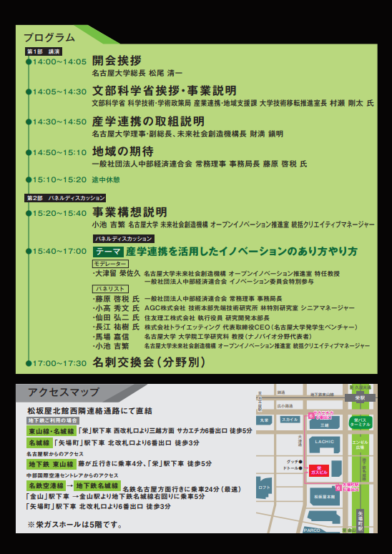
Example of cooperation with universities -1
Nagoya University Open Innovation Institute Kickoff Symposium

Slide 30
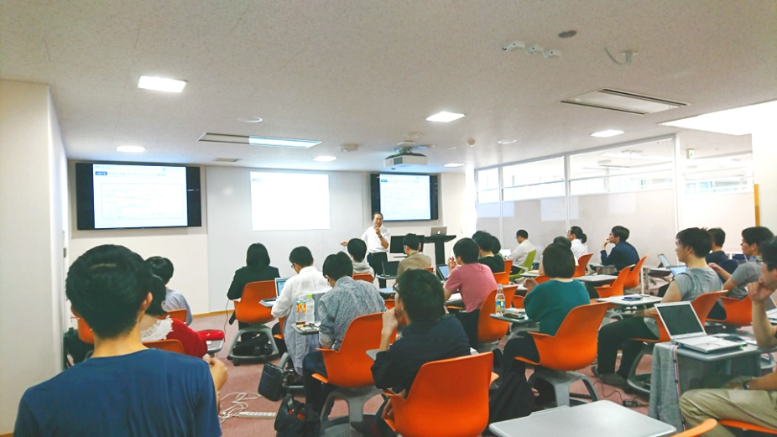
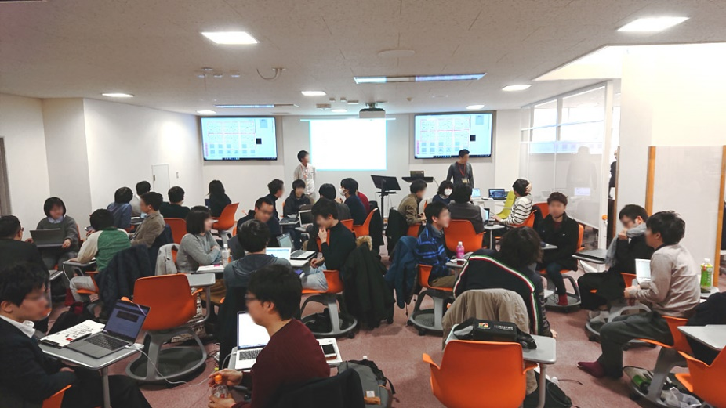
Example of cooperation with universities -2
University of Electro-Communications Data
Entrepreneur
Planning and management of fellowship courses
[Data Entrepreneur Practice]
[Data Scientist Specific Lecture]

Slide 31
[window]
Campus Create Co., Ltd. (University of Electro-Communications TLO)
Shinobu Masuda Coordinator for Industry-Academia-Government Collaboration
1 -5 -1 Chofugaoka, Chofu, Tokyo 182 -8585 University of Electro-Communications Industry-Academia-Government Collaboration Center
TEL: 042-490-5734 FAX: 042-490-5727
Email: info@campuscreate.com
Homepage: http://www.campuscreate.com

